Slide 1


Capstone Project-I
WE WORKER’S
Guided by : Dr. Jatin Modh
Aditya Patel Dhyey Patel Khushi Lodha Vishva Raval
IT23B33 IT23B34 IT23B22 IT23B45

Slide 2

Role of Members :
Vishwa Raval : UI and Admin
Aditya Patel : UI and API
Dhyey Patel : UI and Admin
Khushi Lodha : UI and API.

Slide 3

Abstract of definition
A platform that connects service providers, including plumbers, mechanical technicians, carpenters, and various other with customers seeking their services.
These platforms typically facilitate the booking, scheduling, and payment processes.
Include features such as job listings, service provider profiles, customer reviews, and communication tools.

Slide 4
Data Dictionary

Slide 5
User Table
No | Field name | Data Type | Constraints | Descriptions
1 | user_ID | Integer | Primary Key | Unique ID for a user
 |  |  | Auto Increment
2 | first_name | Char(max_length=20) | Not Null | First name of user
3 | last_name | Char(max_length=20) | Not Null | Last name of user
4 | email | Char(max_length) | Not Null | email ID of
 |  |  | Unique | the user
5 | phone | Char(max_length) | Not Null | Contact number
 |  |  | Unique | of the user
6 | location | Char(max_length=190) | Not Null | Location of the user
7 | pincode | Integer(max_length=10) | Not Null | Pincode of the user
8 | password | Char(max_length=100) | Not Null | Password of the user
9 | role | Boolean | Not Null | Role i,e,. Admin or user

Slide 6
Technician Table
No | Field name | Data Type | Constraints | Descriptions
1 | Technician_ID | Integer | Primary Key | Unique identifier for each
 |  |  | Auto Increment | technician in the table.
2 | Technician_name | Char(max_length=35) | Not Null | Name of the Technician
3 | Technician_email | Char(max_length) | Not Null | email ID of the
 |  |  | Unique | Technician
4 | Technician_phone | Integer | Not Null | Contact number of the
 |  |  | Unique | Technician
5 | Technician_password | Char(max_length=100) | Not Null | Password of the Technician
6 | Technician_location | Char(max_length=190) | Not Null | Technician Location
7 | Area_pincode | Char(max_length=10) | Not Null | Pincode of Technician

Slide 7
Location Table
No | Field name | Data Type | Constraints | Descriptions
1 | location_ID | Integer | Primary Key
 |  |  | Auto Increment | Unique Id of location
2 | area_name | Char(max_length=100) | Not Null | Area of Location
3 | Pin_code | Integer(max_length=10) | Not Null | Area Pincode
4 | Latitude | Double | Not Null | Latitude of Location
5 | Longitude | Double | Not Null | Longitude of location
6 | Is_active | Boolean | Not Null | Is Active or not
7 | Created_at | Time | Not Null | Time of location created
8 | Updated_at | Time | Not Null | Time of location Updated

Slide 8
Service_Category Table
No | Field name | Data Type | Constraints | Descriptions
1 | ServiceCate_ID | Integer | Primary Key
 |  |  | Auto Increment | Unique Id of category
2 | ServiceCate_name | Char(max_length=30) | Not Null | Name of service category
3 | Service_icon | BLOB | Not Null | Icon of category
4 | Service_isActive | BOOL | Not Null | Service is Active or Deactive

Slide 9
Service Table
No | Field name | Data Type | Constraints | Descriptions
1 | Service_ID | Integer | Primary Key | Unique service ID
 |  |  | Auto Increment
2 | Service_type | Char(max_length=100) | Not Null | Type of Service
3 | Service_icon | BLOB | Not Null | Icon of Service
4 | Service_description | Char(max_length) | Not Null | Description of Service
5 | Service_price | Decimal(max_digits=10) | Not Null | Price of Particular Service
6 | Service_isActive | BOOL | Not Null | Service is Active or Not

Slide 10
Book_item Table
No | Field name | Data Type | Constraints | Descriptions
1 | Booking_item_ID | Integer | Primary Key | Unique ID of Booking_item
 |  |  | Auto Increment
2 | Service_ID | Integer | Foreign Key | unique Service ID as FK
3 | Technician_ID | Integer | Foreign Key | unique Technician ID as FK
4 | Status | BOOL | Not Null | Pending or Completed
5 | Review_Rating | Integer | Not Null | Rating and Review of Service

Slide 11
Scheduling Table
No | Field name | Data Type | Constraints | Descriptions
1 | Scheduling_ID | Integer | Primary Key | Unique Scheduling ID
 |  |  | Auto Increment
2 | Booking_item_ID | Integer | Foreign Key | unique Booking_Item as FK
3 | Date | DATE | Not Null | Date for a service
4 | Time | TIME | Not Null | Time for a Service

Slide 12
Booking_info Table
No | Field name | Data Type | Constraints | Descriptions
1 | Booking_info_ID | Integer | Primary Key | Unique Booking_info ID
 |  |  | Auto Increment
2 | User_ID | Integer | Foreign Key | unique user ID as FK
3 | Booking_item_ID | Integer | Foreign Key | unique_item_ID as FK

Slide 13
Payment Table
No | Field name | Data Type | Constraints | Descriptions
1 | Payment_ID | Integer | Primary Key | Unique Payment ID
 |  |  | Auto Increment
2 | Booking_info_ID | Integer | Foreign Key | unique Booking_info ID as FK
3 | Amount | FLOAT | Not Null | Amount of Service
4 | Date_Time | DATETIME | Not Null | Date & Time of Paying Bill
5 | Mode | Char(max_length) | Not Null | Mode of Payment

Slide 14
Invoice Table
No | Field name | Data Type | Constraints | Descriptions
1 | Invoice_ID | Integer | Primary Key | Unique Invoice ID
 |  |  | Auto Increment
2 | Book_info_ID | Integer | Foreign Key | Book_info_ID as FK
3 | Payment_ID | Integer | Foreign Key | Payment_ID as FK
4 | Date_time | DATETIME | Not Null | Date_time of Invoice

Slide 15

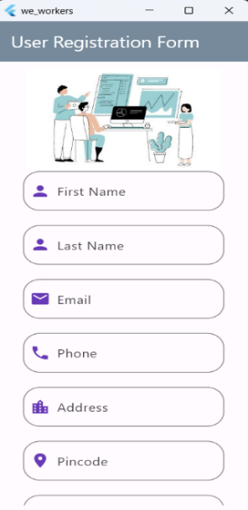
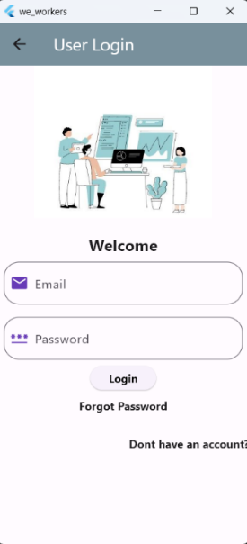
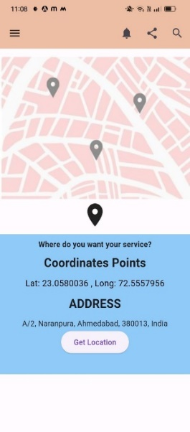
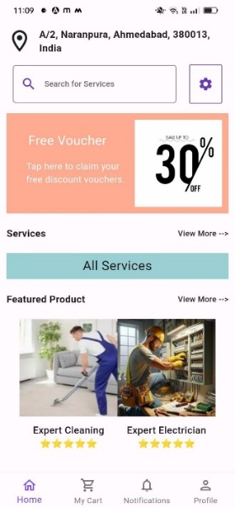
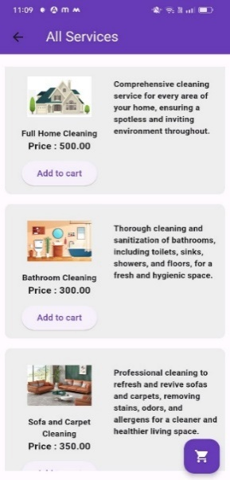
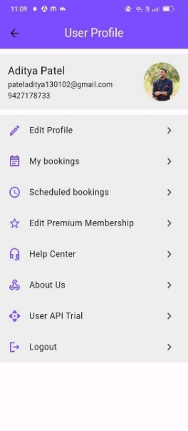
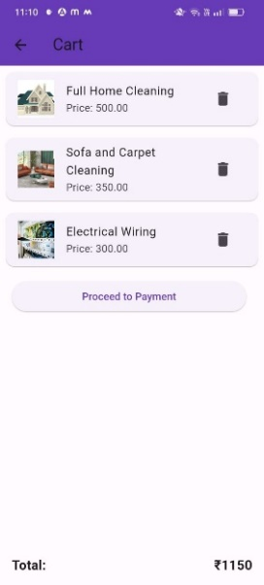
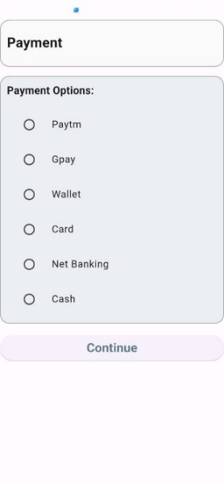
Roles
Sign up
Login
Home
Services
Location
User profile
cart
Payment

Slide 16

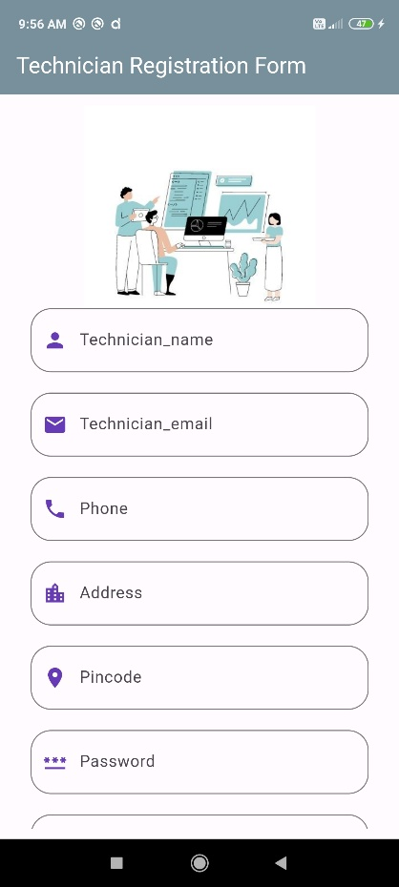
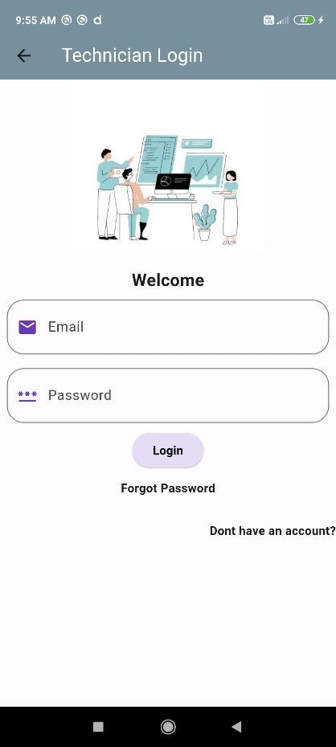
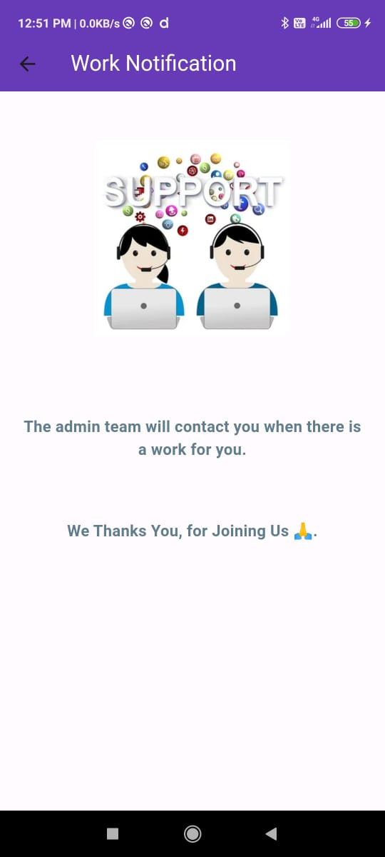
Roles
Sign up
Login
Home Page

Slide 17
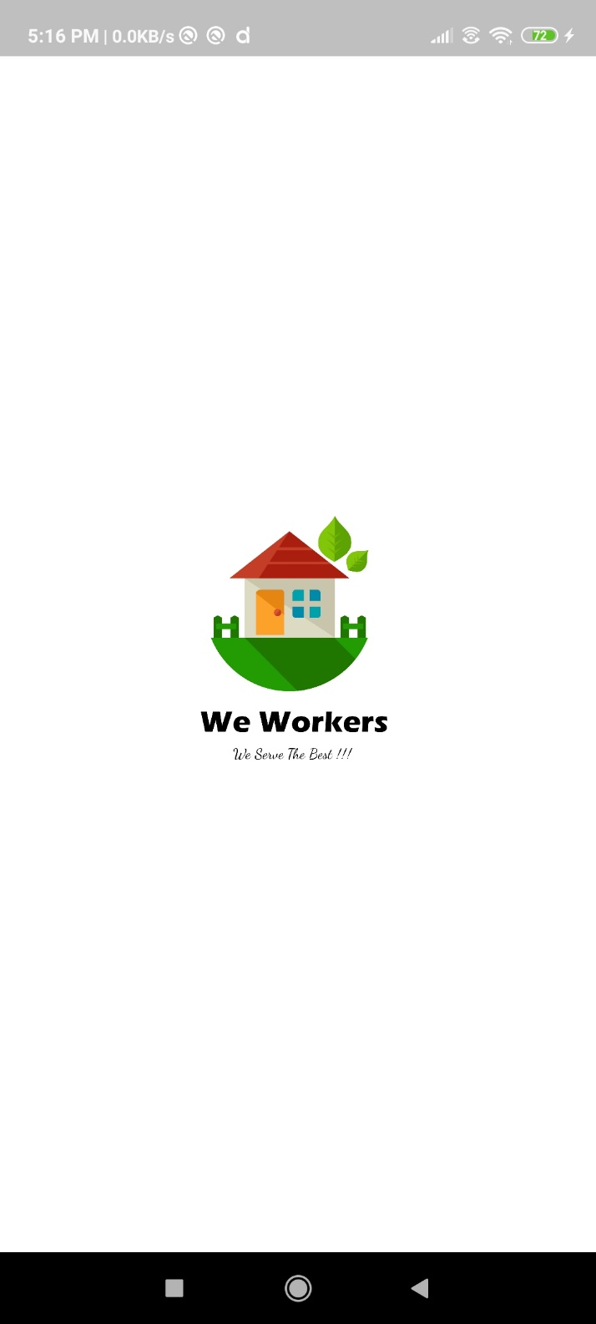
A splash screen at the beginning of an application

Slide 18
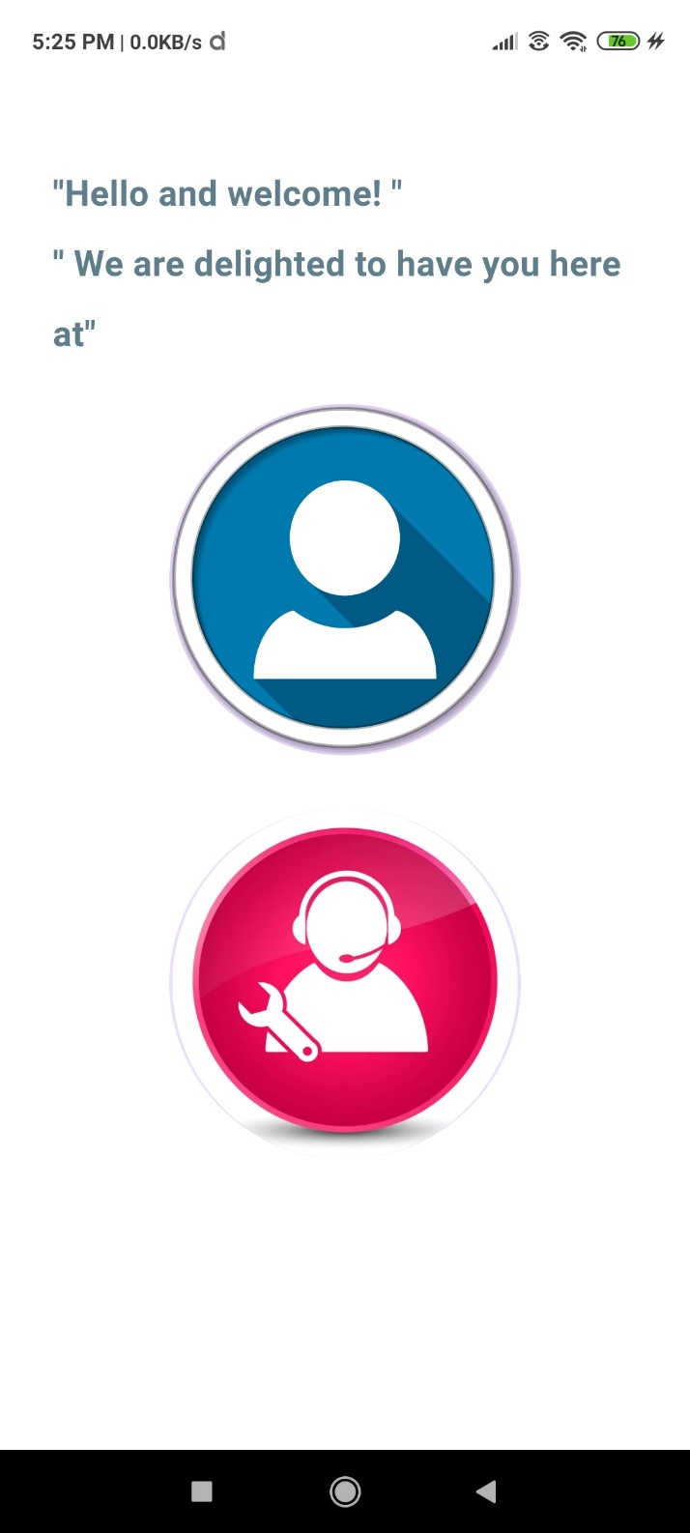
Basically there are 2 options are shown :user & technician.
They will ask for a choice for what purpose they want to use.

Slide 19
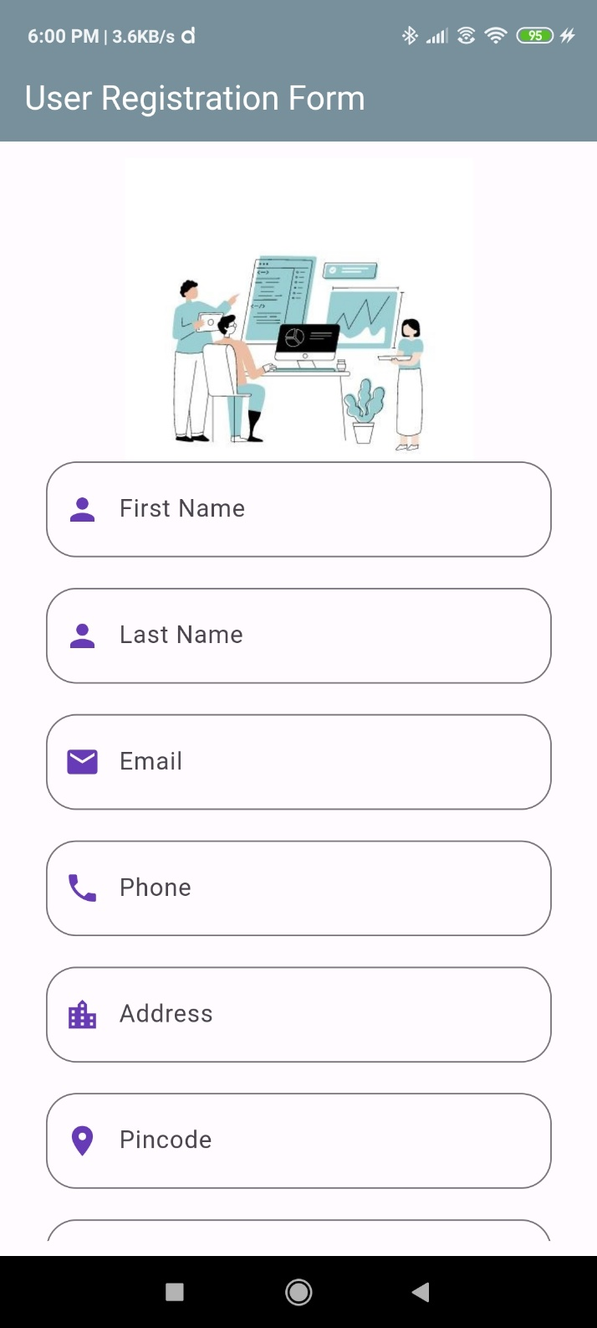
Next there is a registration page : in it we have username, email & password

Slide 20
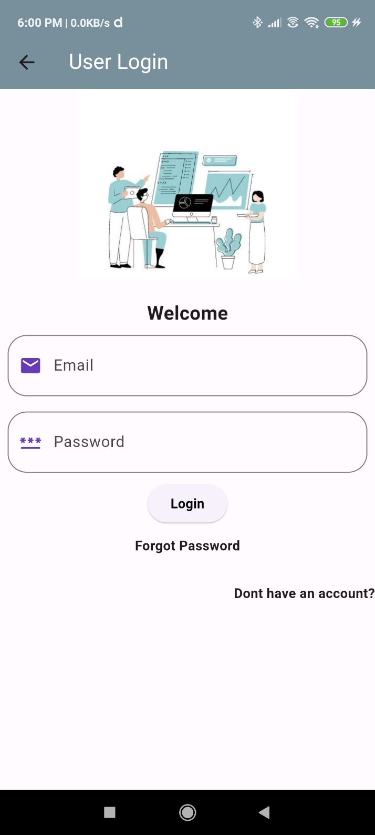
Next the user used to login in this page

Slide 21
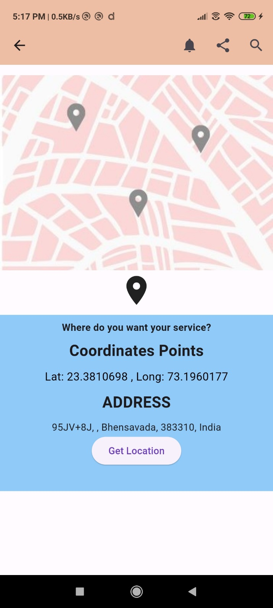
Then in next page we will be fetching location from the user

Slide 22
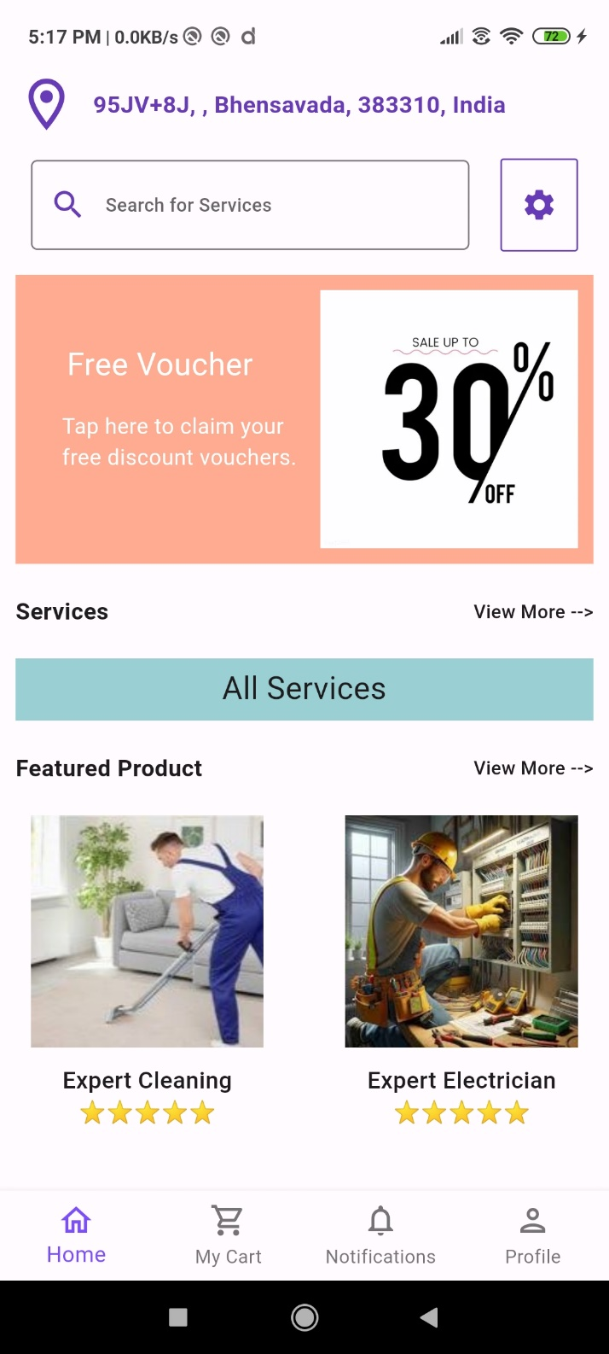
Next there will be a user home page from where the user used to choose it's category.

Slide 23
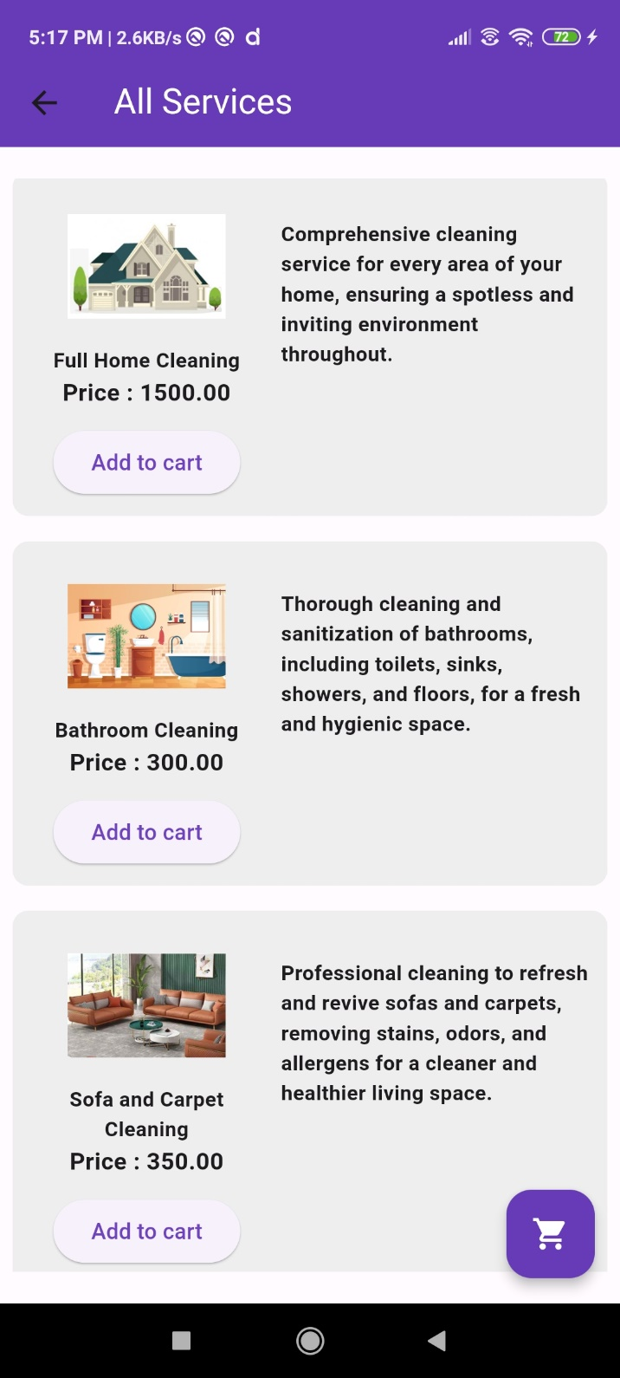
Then there will be all Sevices in it

Slide 24
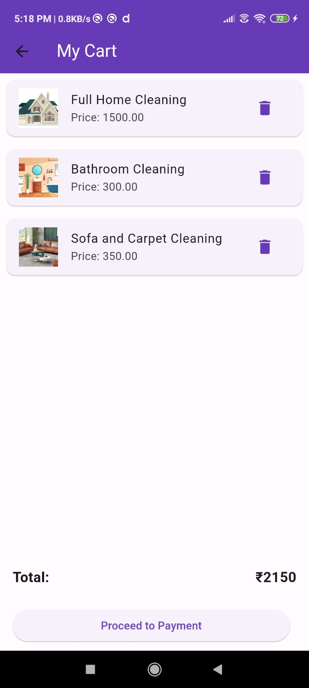
Next there will be Add Various Services In Cart Page.

Slide 25
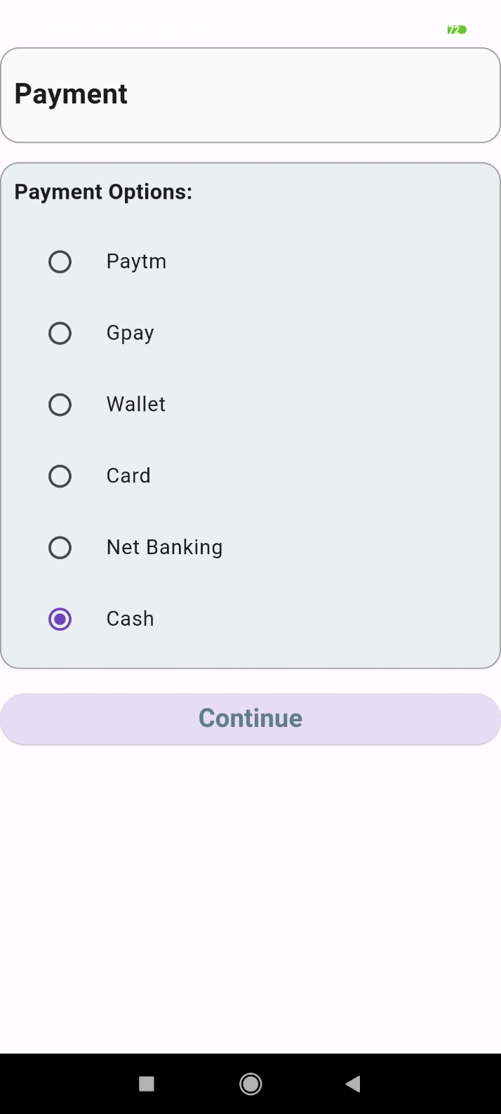
Next Payment Options page.

Slide 26
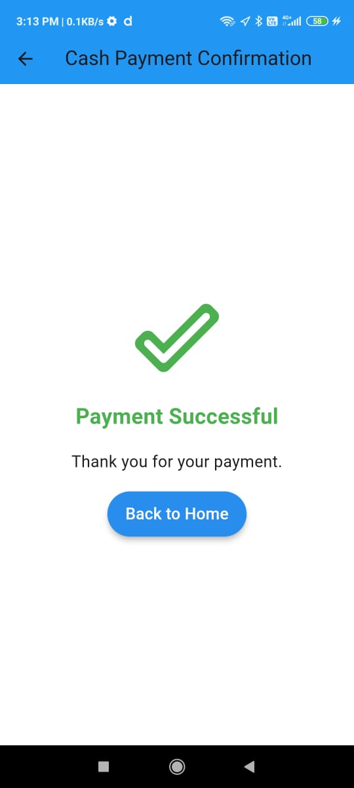
Cash Payment Successfully done

Slide 27
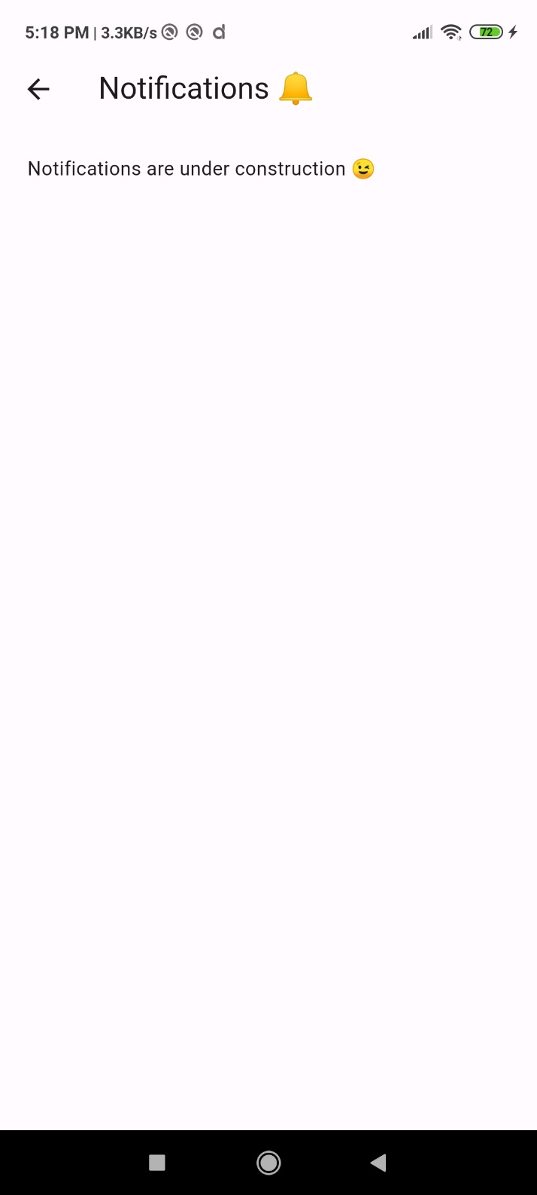

A notification page

Slide 28
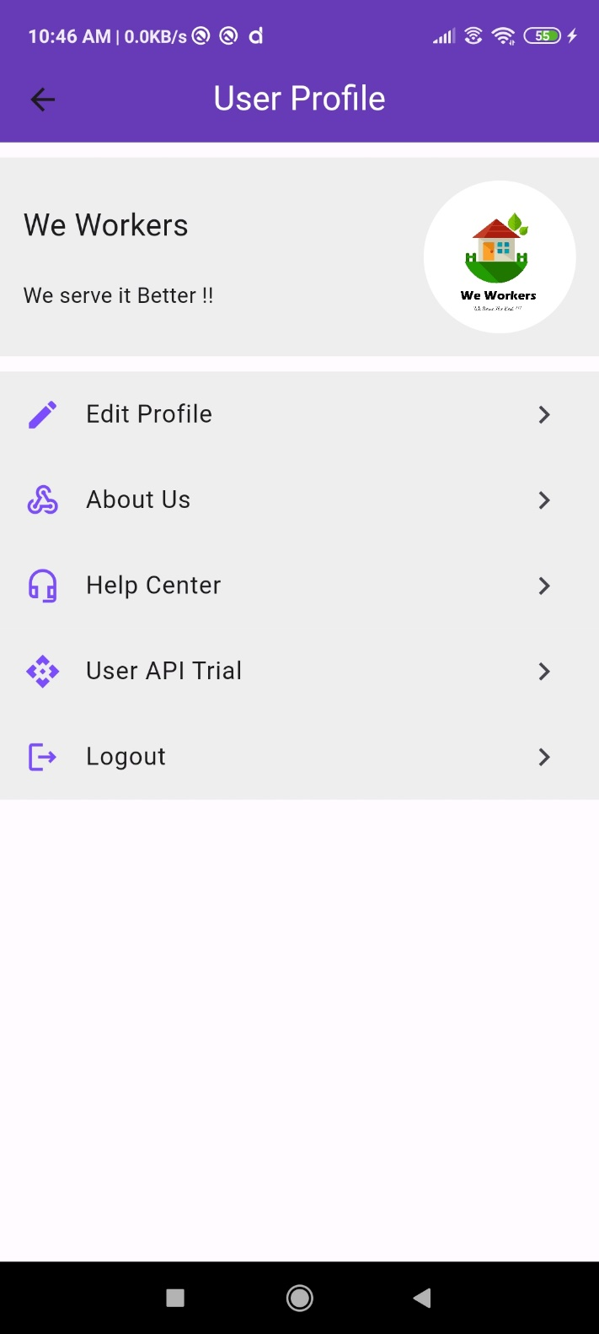
Then it’s User Profile page.

Slide 29
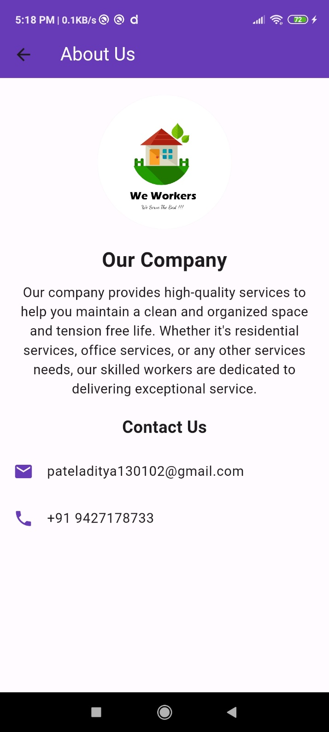
About us page.

Slide 30
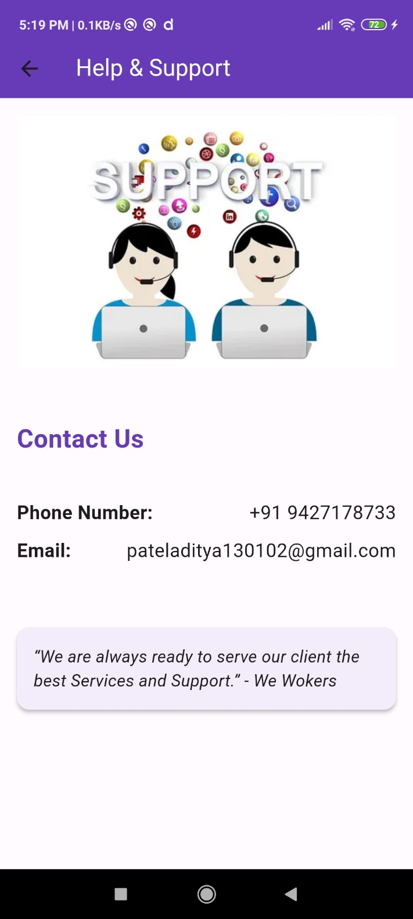
Help & Support page.

Slide 31
Technician

Slide 32
Basically there are 2 options are shown :user & technician.
They will ask for a choice for what purpose they want to use.

Slide 33

Next there is a registration page : in it we have username email password

Slide 34
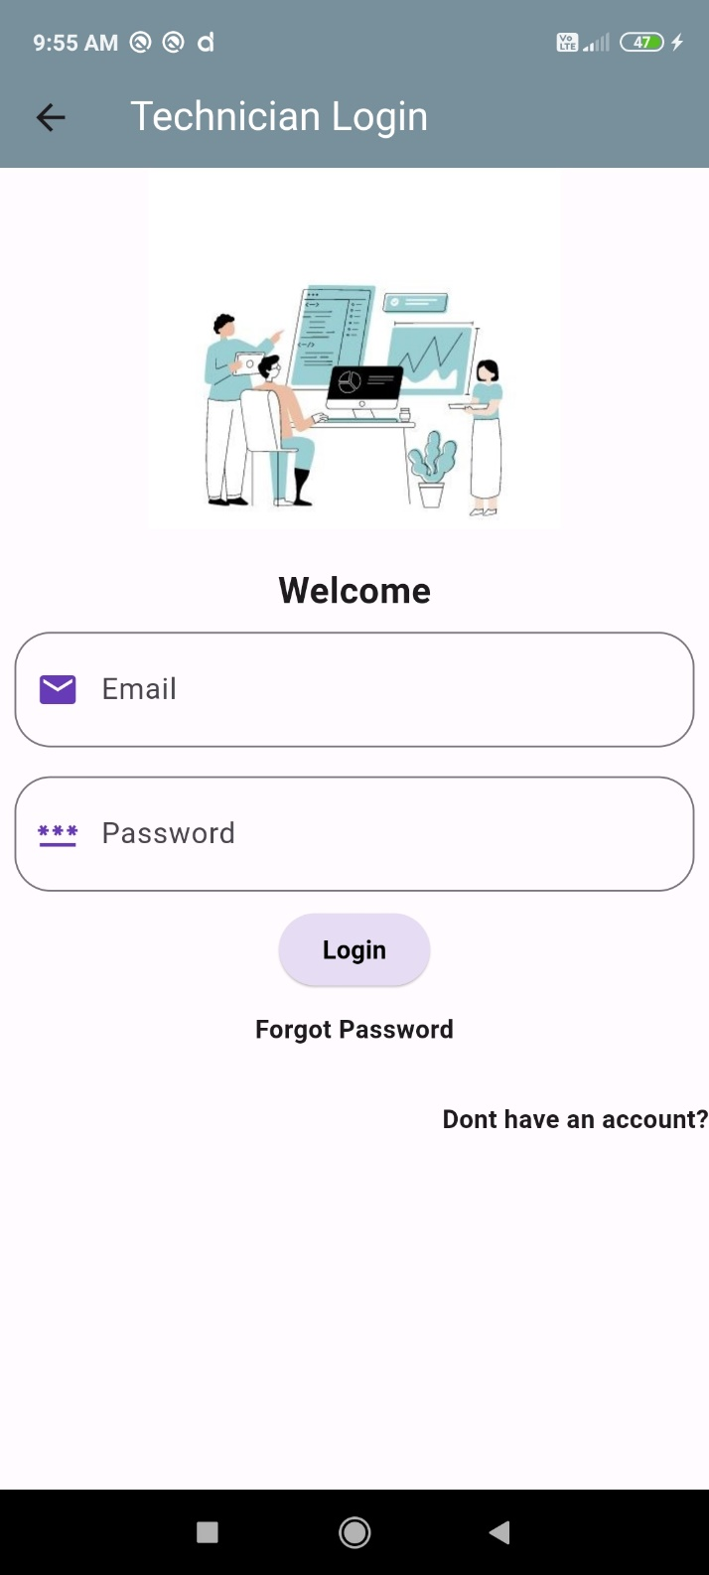
Next the user used to login in this page

Slide 35
Next the Support Page In Technician.

Slide 36
Admin Panel

Slide 37
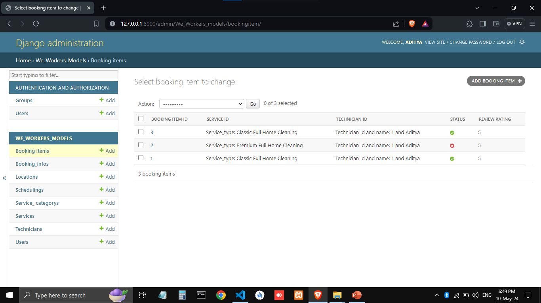

Slide 38
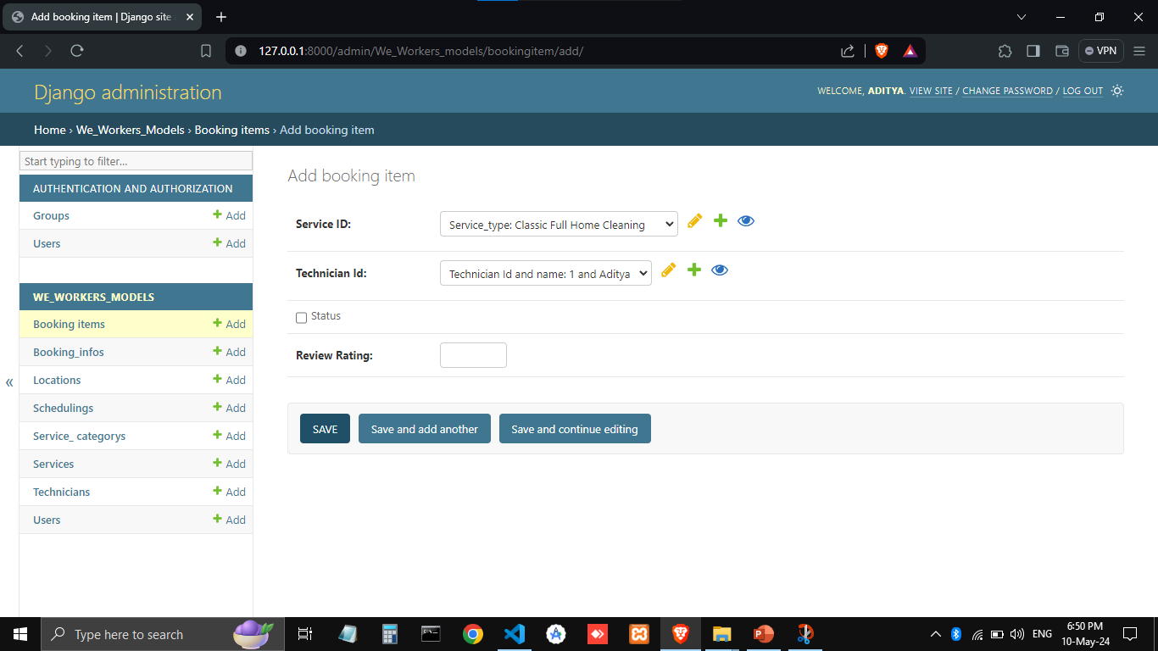

Slide 39
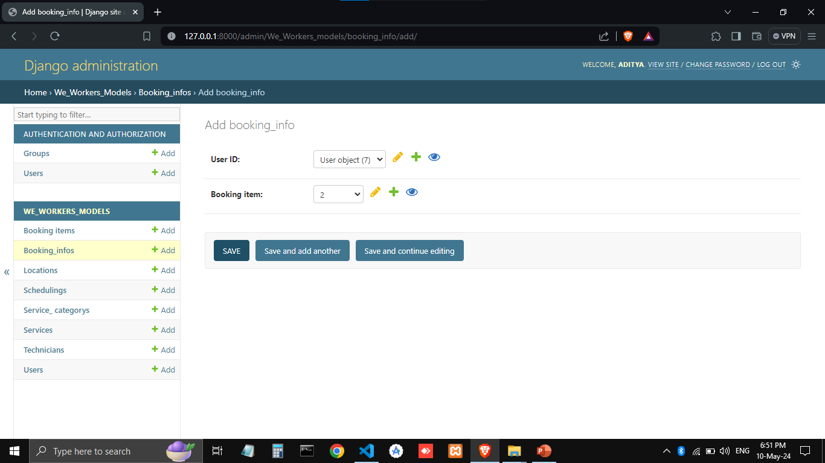

Slide 40
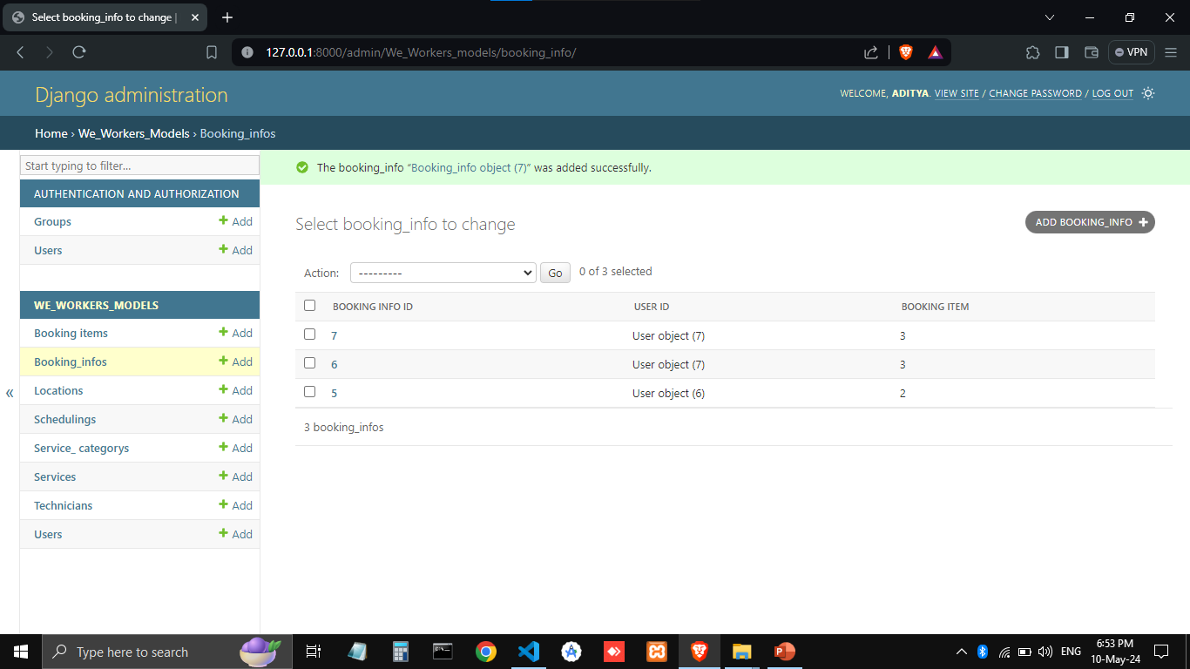

Slide 41
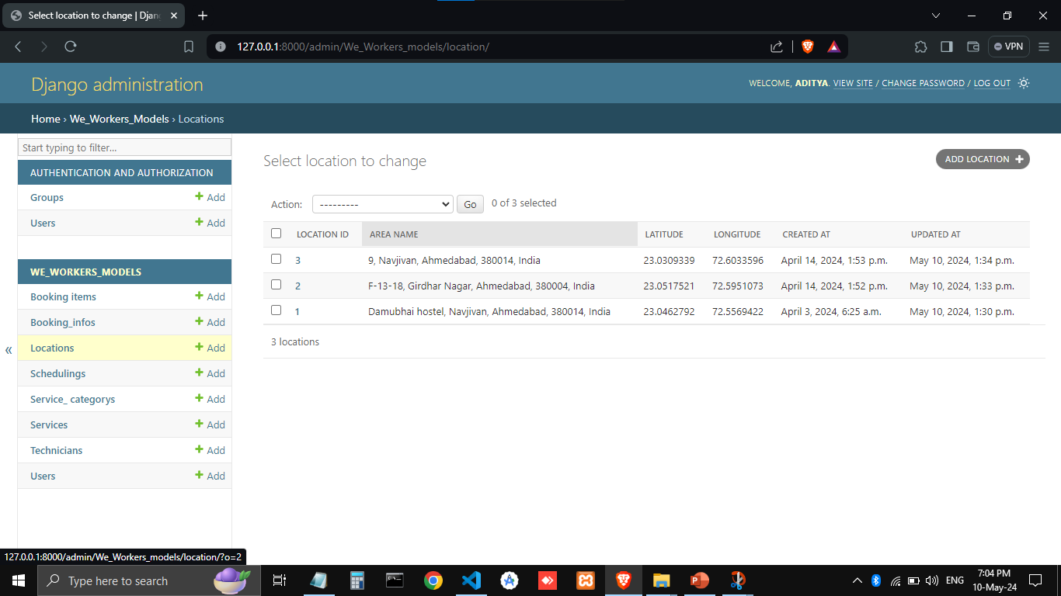

Slide 42
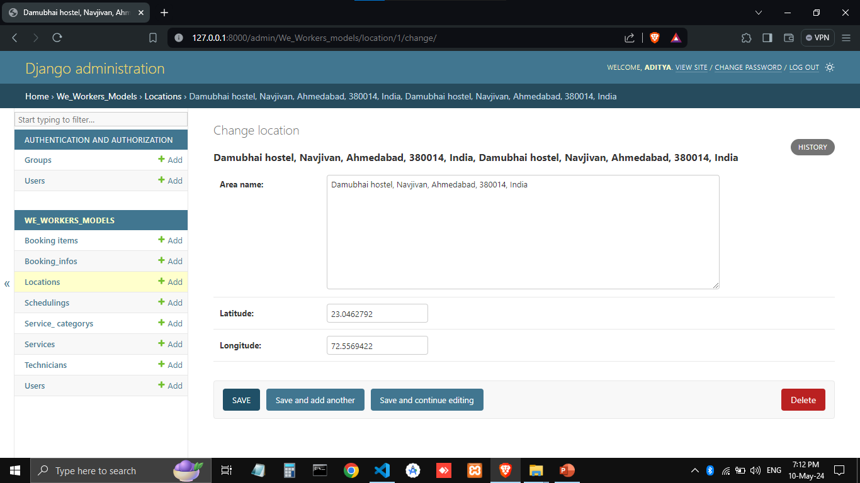

Slide 43
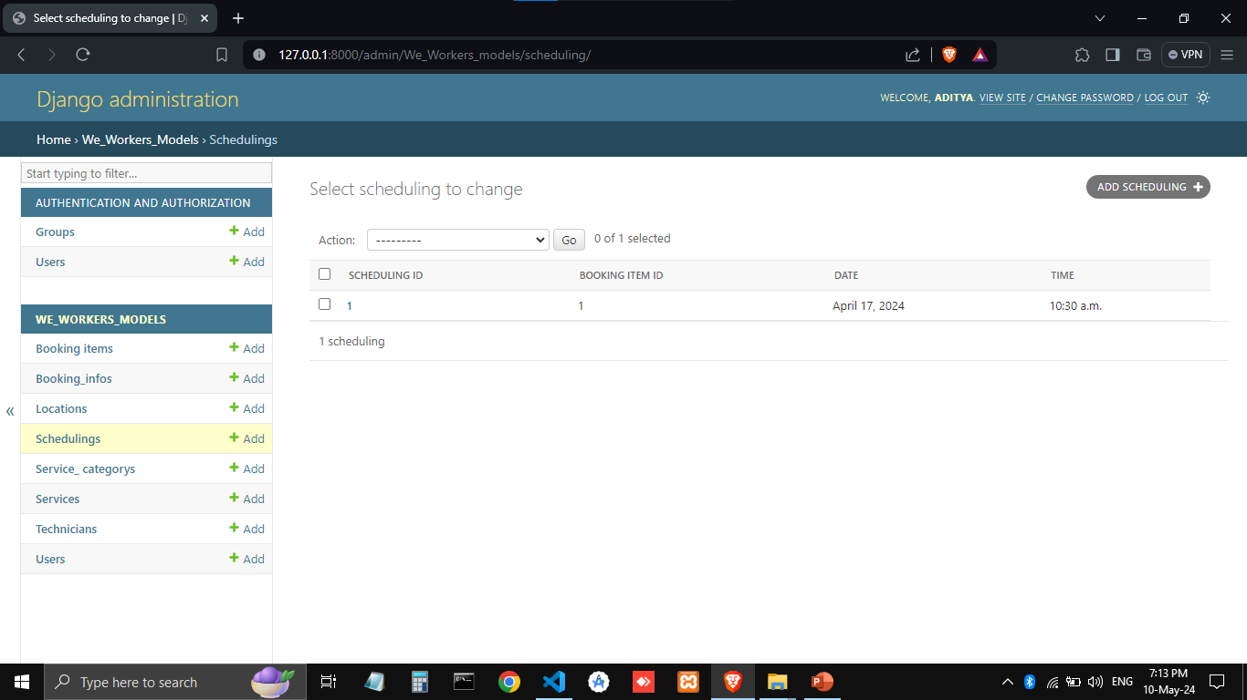

Slide 44
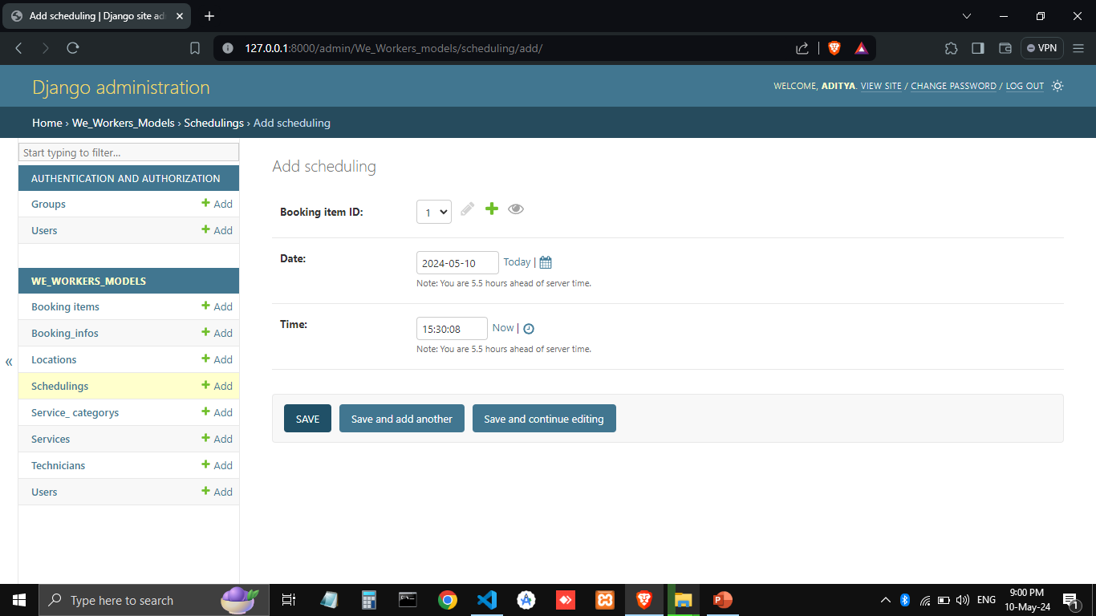

Slide 45
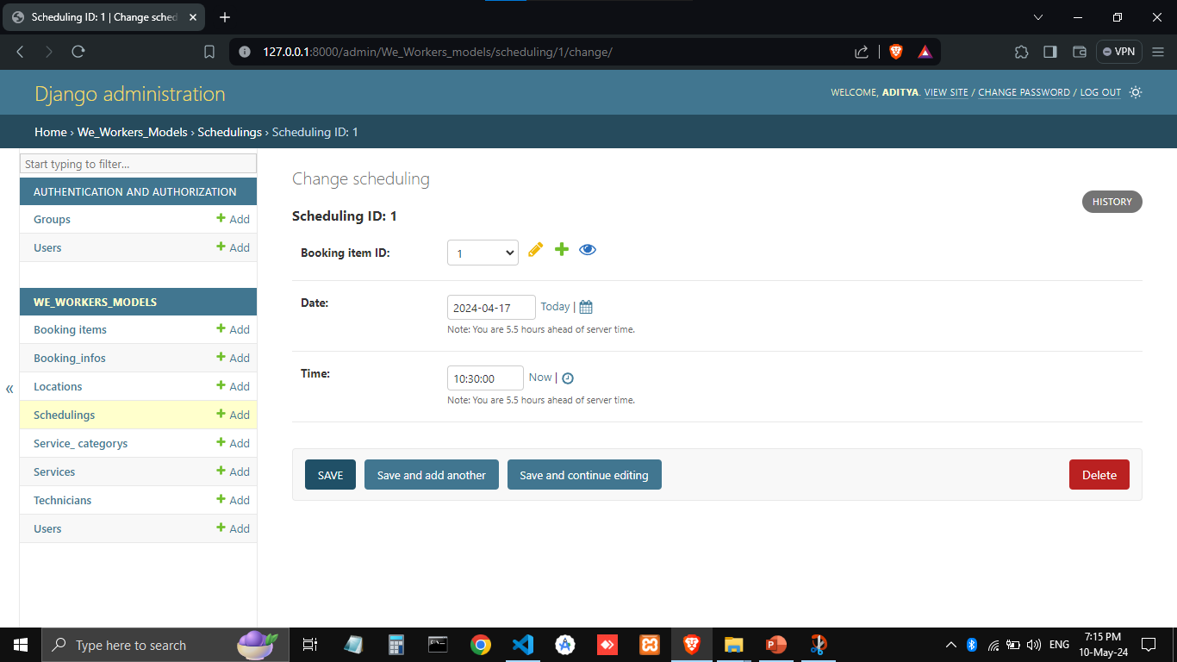

Slide 46
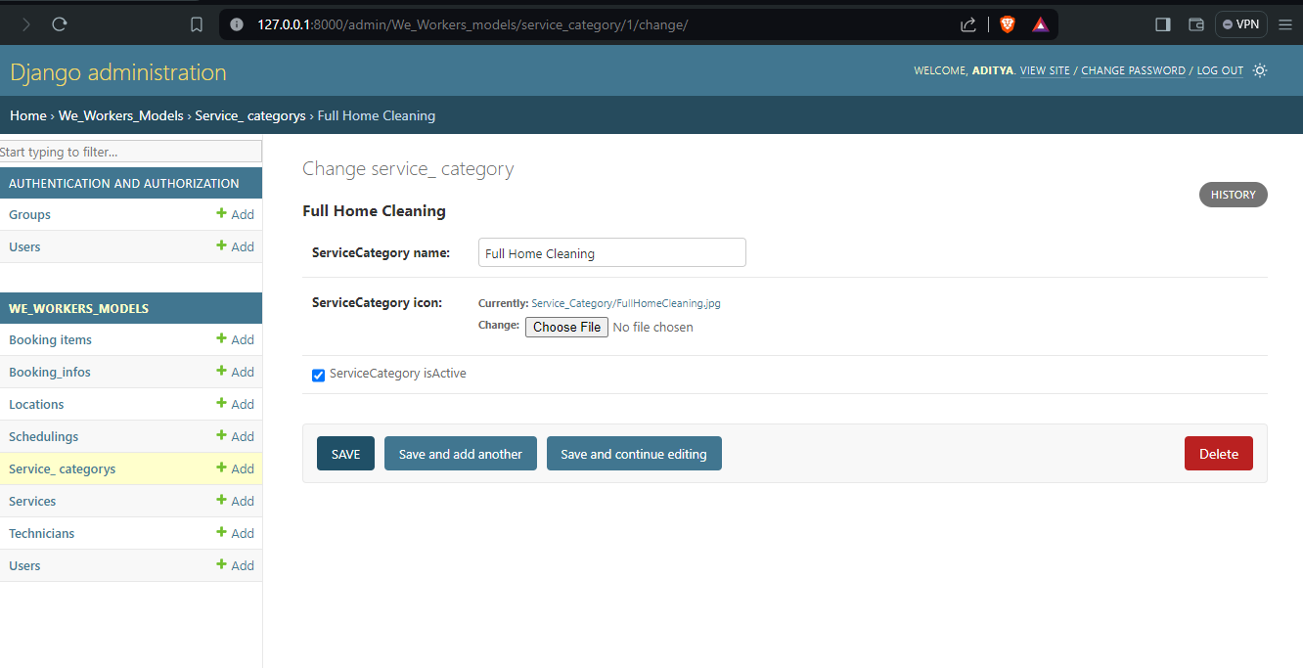

Slide 47
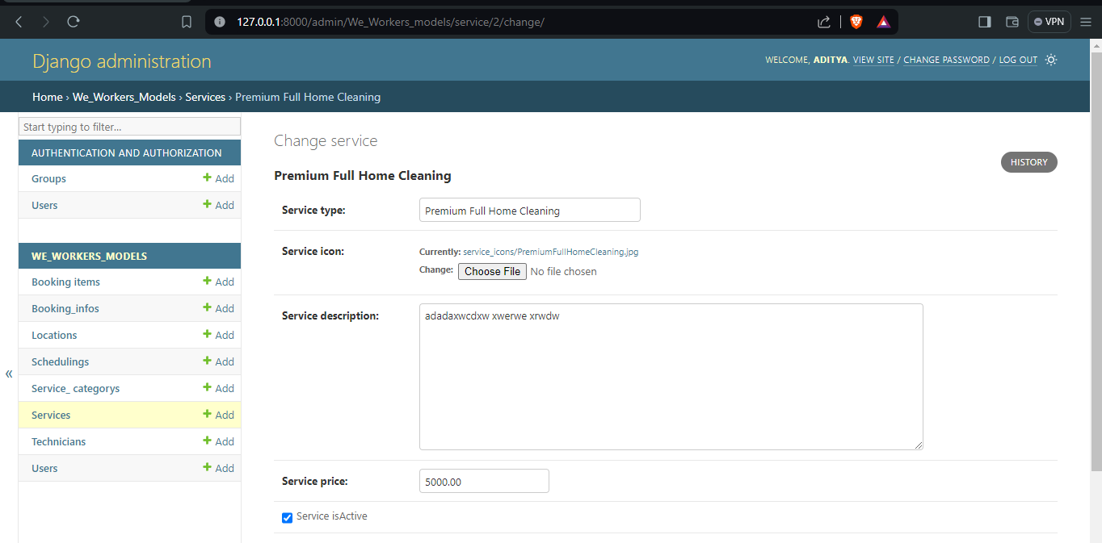

Slide 48
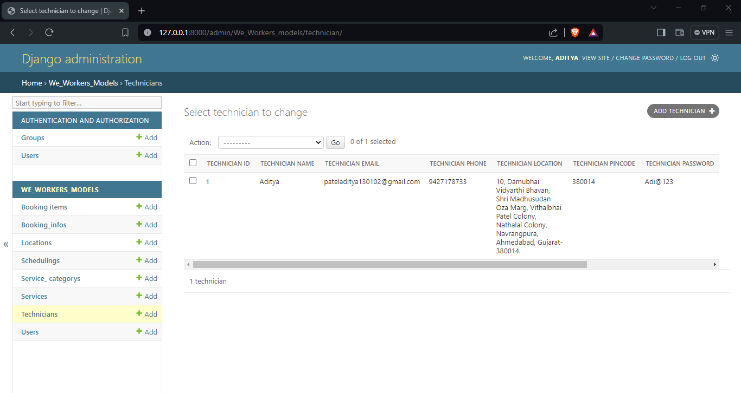

Slide 49
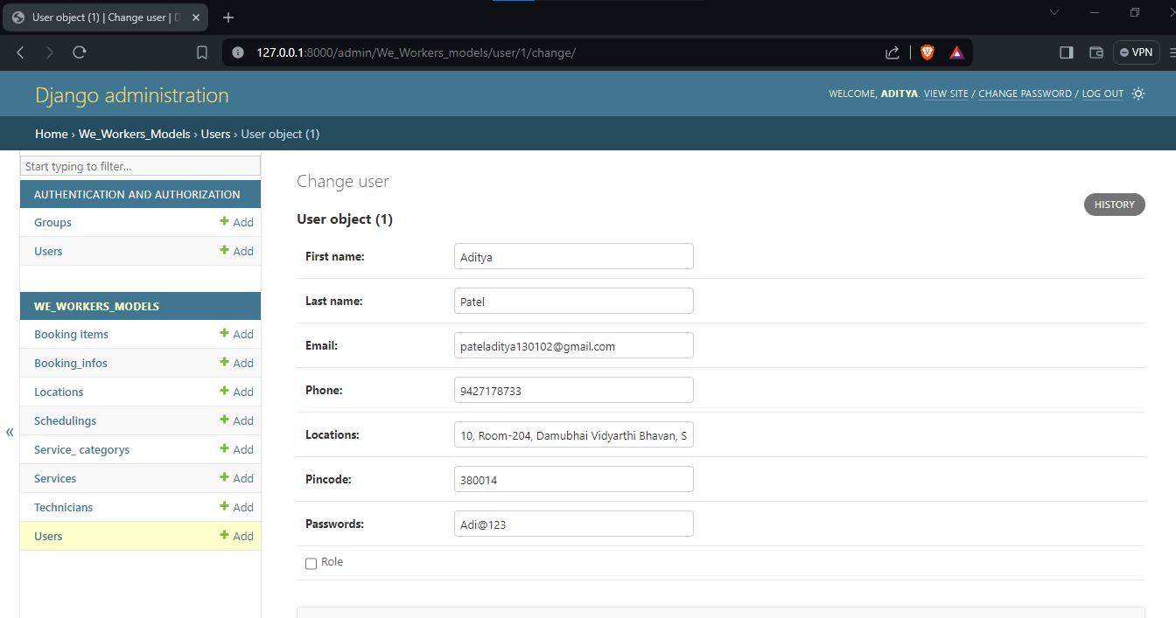

Slide 50
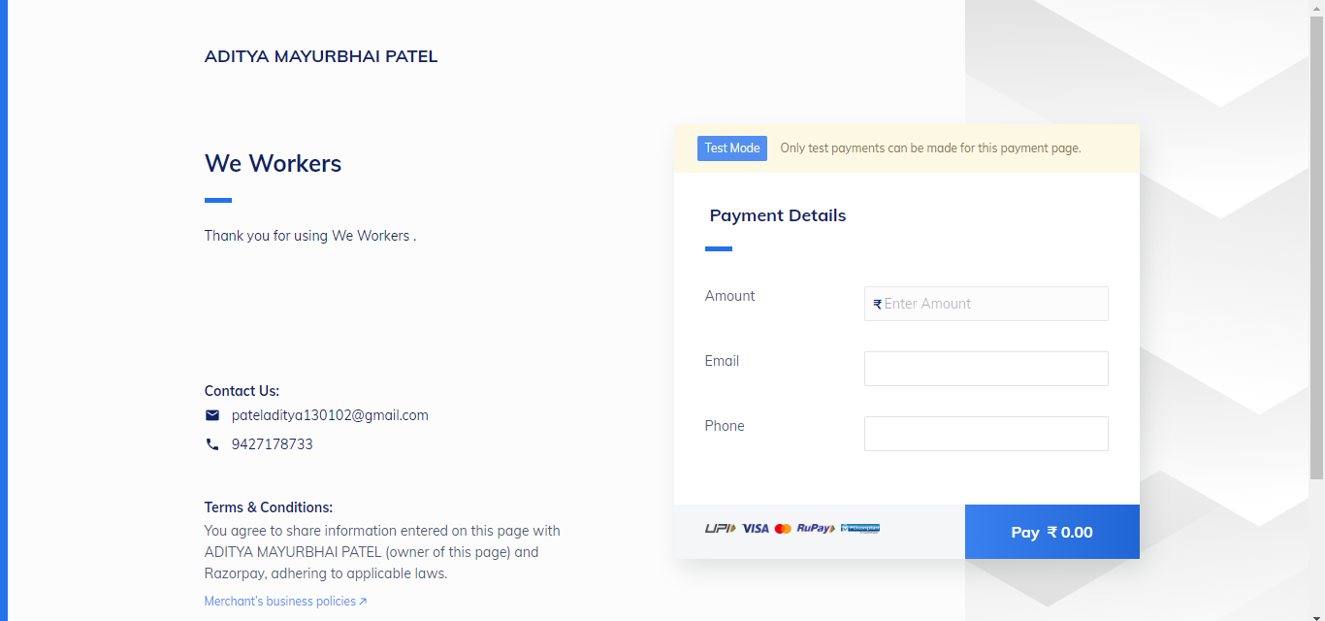

Slide 51
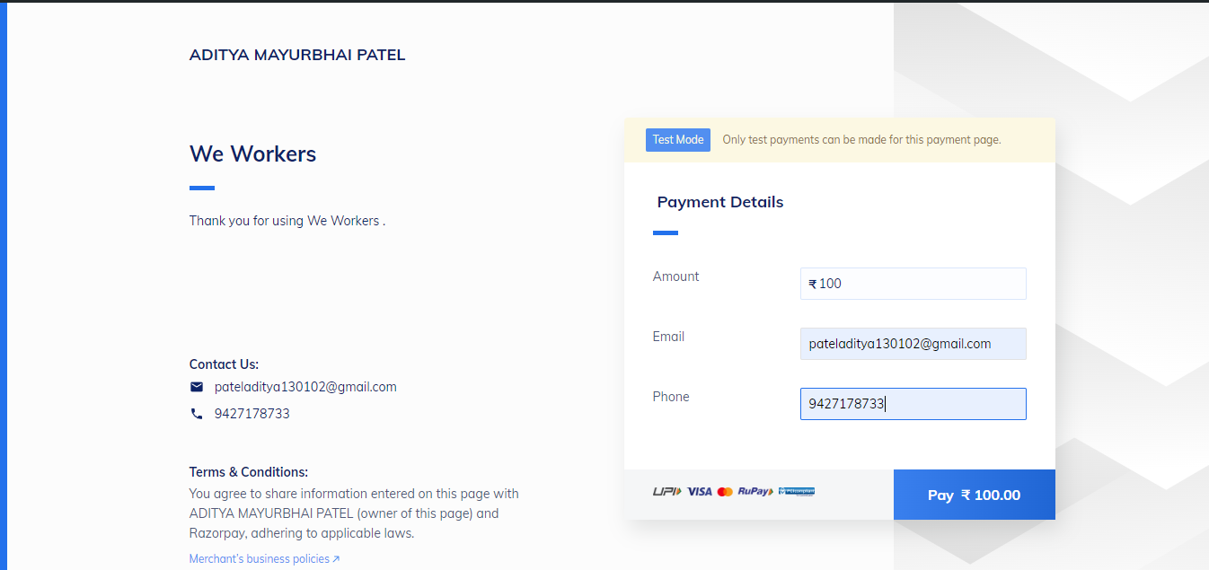

Slide 52
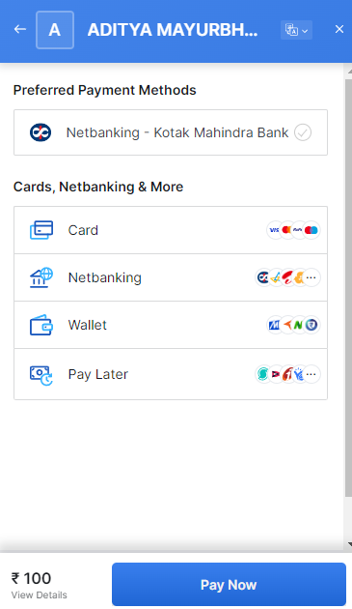

Slide 53
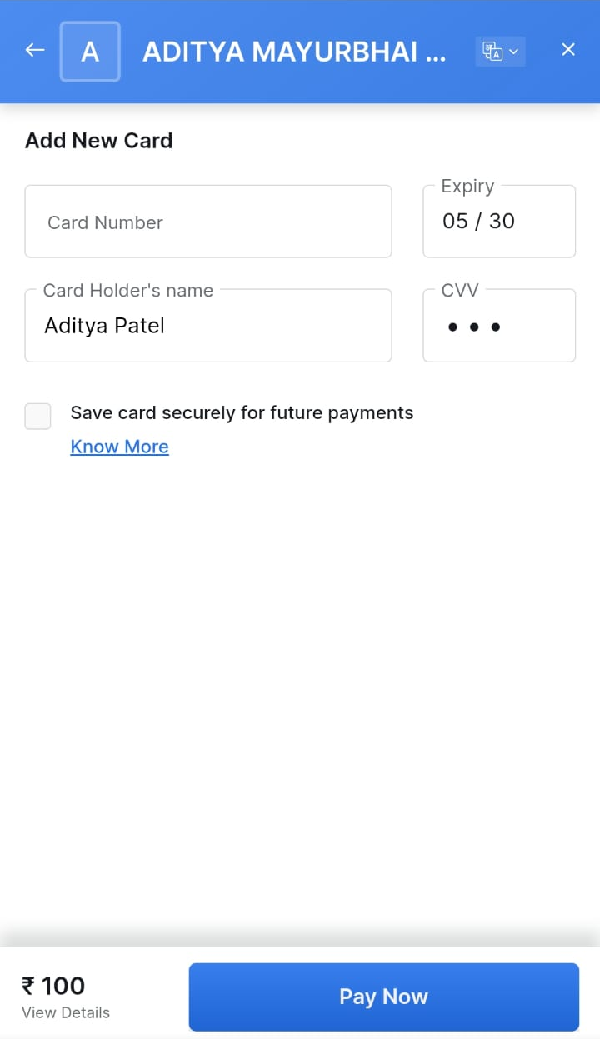

Slide 54
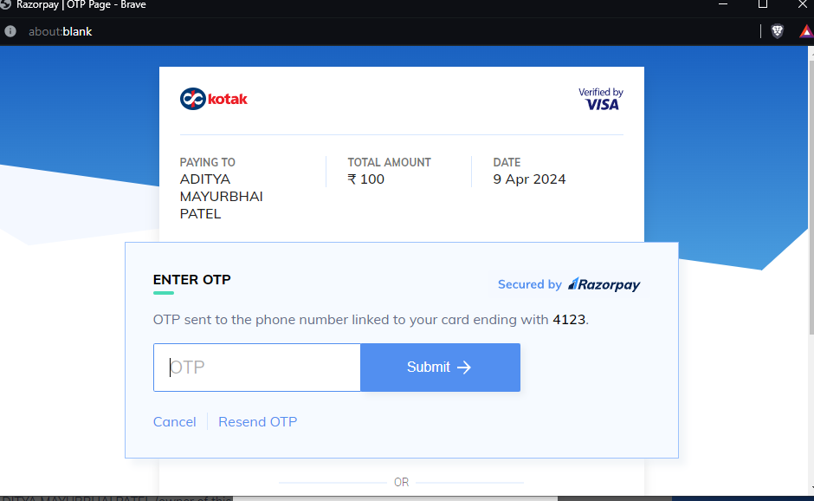

Slide 55
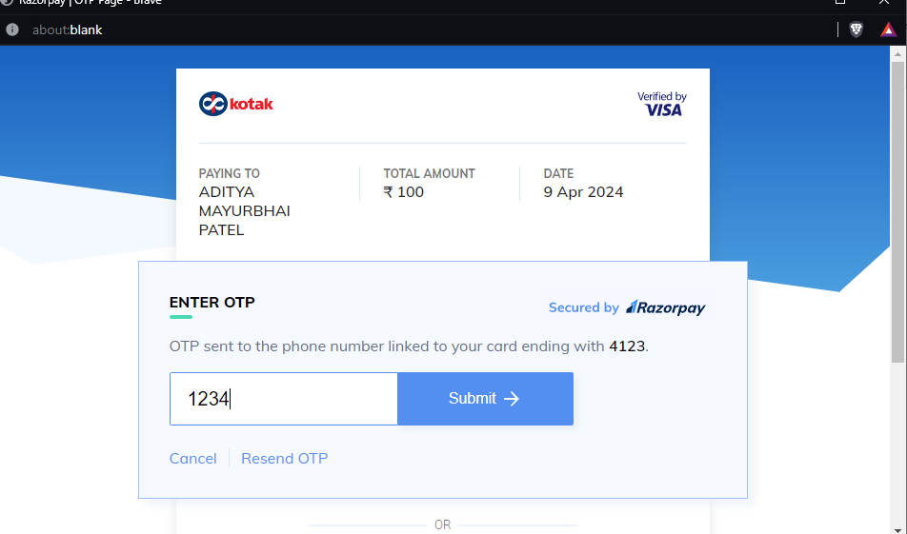

Slide 56
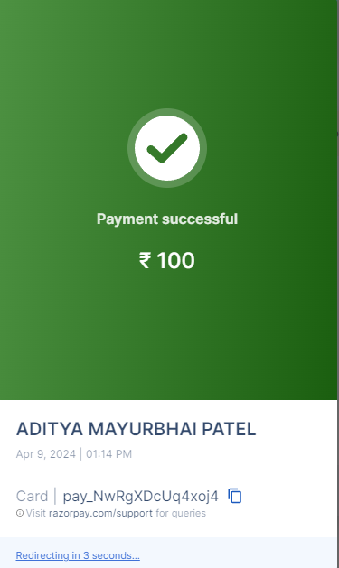

Slide 57
References
https://www.odtap.com/top-10-on-demand-home-service-apps-to-use-in-2023/#:~:text=A%20big%20brand%20in%20the,cleaning%2C%20pest%20control%2C%20etc
https://mobisoftinfotech.com/resources/blog/on-demand-home-services-startups/
Wikipedia
Quora.com

Slide 58
Thank You

